Slide 1

Intelligent Plagiarism Detector
Detect Similarity. Protect Originality
DSA Project — Review 3
Snigdha Patlolla · 2510030269 | Shravya · 2510030123

Slide 2
Proposed Methodology
Core Processing Pipeline
Key Methodology Components
01
02
Document Input
Document Upload
Text Preprocessing
Accept multiple document formats for flexible submission
Extract text from submitted files across multiple formats
Normalize and clean textual data — remove noise, standardize case and whitespace
Algorithmic Detection
03
04
Apply KMP, Rabin-Karp, and LCS in a unified pipeline
Tokenization
Pattern & Similarity Analysis
Break text into comparable units for algorithmic processing
Apply KMP, Rabin-Karp, and LCS algorithms
Score Generation
Compute plagiarism percentage from algorithmic outputs
05
Score Calculation & Visualization
Result Presentation
Generate similarity metrics and present findings via web interface
Display interpretable results through web-based interface

Slide 3




ARCHITECTURE
System Workflow
End-to-end architecture spanning four sequential stages — from document ingestion to result visualization.
Input Stage
Processing Stage
User uploads reference and submitted documents
System extracts text from various file formats (PDF, TXT, DOCX)
Text preprocessing and normalization
Tokenization and segmentation into comparable units
Algorithm Stage
Output Stage
KMP — efficient substring search
Rabin-Karp — rolling hash comparison
LCS / DP — similarity analysis
Similarity score calculation
Plagiarism analysis and visualization
Results on web interface

Slide 4
DSA Techniques Used
KMP
Rabin-Karp
LCS / DP
Knuth-Morris-Pratt Pattern Matching
Hash-Based String Matching
Longest Common Subsequence
Efficient pattern matching without unnecessary re-comparisons
Uses LPS (Longest Proper Prefix which is also Suffix) array
Time complexity: O(n + m) — linear in document length
Hash-based string matching for rapid pattern location
Uses rolling hash for efficient segment comparison
Effective for finding multiple matching patterns simultaneously
Identifies common subsequences between documents
Measures similarity even when text is rearranged
Builds optimal solution through subproblem decomposition
Algorithm Comparison
Algorithm | Main Purpose | Key Idea
KMP | Pattern matching | LPS array / prefix information
Rabin-Karp | Hash-based matching | Rolling hash computation
LCS / DP | Similarity analysis | Optimal substructure via dynamic programming

Slide 5
Novelty of Developed Methodology
What Makes This Approach Innovative
Traditional vs. Our Approach
Multi-Algorithm Integration
Traditional Approach
Combines KMP, Rabin-Karp, and LCS within a single cohesive workflow — no prior approach integrates all three for plagiarism detection
Single or basic matching algorithm → Limited accuracy and shallow textual analysis
Algorithmic Comparison
Word-count or keyword matching only
No structural text analysis
Opaque similarity scoring
Performs structured DSA-based text comparison instead of simple word-count or surface-level matching
Our Approach
Interpretable Results
Multi-stage DSA-based similarity analysis → Structured, algorithm-focused processing
Converts algorithmic similarity metrics into understandable plagiarism scores for end users
Three complementary algorithms combined
Pattern, hash, and subsequence analysis
Transparent, interpretable results
Practical Implementation
Integrates algorithmic processing with a web-based interface for real-world usability

Slide 6
Datasets / Inputs
Input Document Types
Test Data Categories
Identical Documents
Reference Document
Same content — exact match baseline
Original/baseline text used as the comparison anchor
Highly Similar
Submitted Document
Significant overlap with minor variations
Text under evaluation — compared against the reference
Partially Similar
Some common sections, mostly different content
Supported Formats
Completely Different
PDF, TXT, and DOCX files — text extracted automatically upon upload
No meaningful overlap between documents
Scalability & Customization
Documents can vary in length without affecting algorithm correctness
Methodology extensible to larger document collections
Threshold values adjustable for different sensitivity levels

Slide 7
Application Scenarios
The Intelligent Plagiarism Detector is adaptable to educational and document-verification environments — anywhere textual originality must be verified systematically.
Academic Assignments
Project Reports
Detect copied or highly similar student submissions
Identify plagiarism in coursework and projects
Compare technical reports for repeated content
Ensure originality in project documentation
Research Documents
Content Verification
Identify overlapping textual content between papers
Check for unattributed similarities in research
Check textual similarity before publishing or submitting
Verify originality of written content

Slide 8
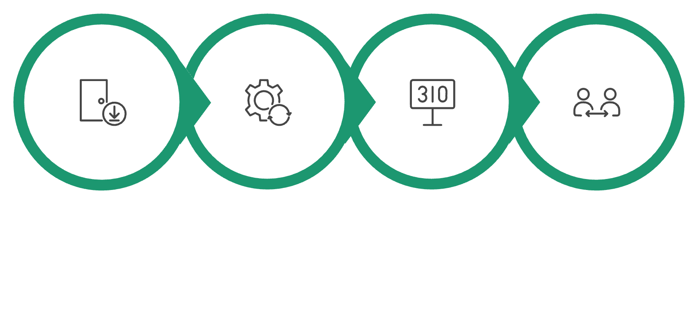
Methodology Evaluation
The completed system was tested through structured test cases covering different levels of textual similarity and document characteristics, verifying correctness and consistency of the multi-algorithm methodology.
Test Cases
Evaluation Flow
TC | Input Condition | Expected Result
TC1 | Identical documents | Very High similarity
TC2 | Highly similar documents | High similarity
TC3 | Partially similar documents | Moderate similarity
TC4 | Completely different documents | Low similarity
TC5 | Different document sizes | Successful comparison
Test Input
Algorithm Processing
Similarity Score
Compare Expected
Evaluation Objectives
Focus on correctness and consistency of methodology across all test cases
Verify algorithmic outputs through the web interface
Confirm system handles documents of varying length reliably

Slide 9
Methodology Evaluation – Results
All test cases produced results aligned with expected behavior. The multi-algorithm approach successfully identifies and quantifies textual similarity across diverse document pairs.
Similarity Score Distribution
Key Observations
Very High Similarity — 95–100%
High Similarity — 75–94%
Consistent Differentiation
Highly Similar Documents: Significant overlap with minor variations consistently detected
Similar documents consistently produce higher similarity scores; unrelated documents produce substantially lower scores
Identical Documents: Exact content match produces near-perfect scores across all three algorithms
Expected Behaviour Confirmed
Output is consistent with all expected test conditions across TC1–TC5
Moderate Similarity — 40–74%
Low Similarity — 0–39%
Different Documents: Unrelated content produces substantially lower scores
Length Invariance
Partially Similar Documents: Some common sections reflected in intermediate scores
System handles documents of varying lengths effectively without degradation

Slide 10
Validation & Discussion
Validation Process
Discussion of Findings
Exact & Near-Exact Matches
Test Case Design
Identical and near-identical documents result in strong, unambiguous similarity scores
Cases designed with varying levels of textual similarity to cover full detection spectrum
Partial Overlap
Systematic Comparison
Documents with some shared content produce intermediate similarity values — correctly differentiated from full matches
Expected and observed behavior compared systematically across all conditions
Unrelated Documents
Interface Verification
Substantially lower similarity confirmed — methodology avoids false positives on unrelated content
Algorithmic outputs verified through application interface for accuracy
Robust Multi-Algorithm Detection
Consistency Check
Multi-algorithm approach demonstrates practical application of DSA concepts in real-world document analysis
Results checked for consistency across multiple independent runs

Slide 11
THANK YOU

